Slide 1
ONLINE LITERARY MANAGEMENT SYSTEM
By:
Sujal Bajracharya
Balram Magar

Slide 2
INTRODUCTION
Captivating Stories Everywhere: Novels have enthralled readers for ages, now in the digital age we have web novels!
Lost in a Sea of Pages?: Finding your perfect read can be a struggle with so many options.
Navigating Your Literary Journey: Our Online Literary Management System is here to help!
Empowering Readers: Take control of your digital library with ease and joy.
Built for Everyone: User-friendly, flexible, and packed with essential features for a smooth reading experience.

Slide 3
PROBLEM STATEMENT
Too Many Reads, Not Enough Order: Online literary content is booming, but managing your personal library can be a nightmare.
Tech-Savvy Only?: Existing solutions might be confusing or require skills not everyone has.
Missing the Mark: Some systems lack key features, leaving readers frustrated and unsatisfied.
Our Solution: A user-friendly system built for everyone, adapting to your needs and preferences.

Slide 4
OBJECTIVES
Effortless Exploration: Navigate your library like a pro with a friendly and intuitive interface.
Read, Write, Organize, Repeat: Create, update, and manage your collection with ease using powerful CRUD functionalities.
Make it Your Own: Categorize, tag, and sort your way to a perfectly personalized library.
One System, Any Story: Dive into all kinds of online reads, from web novels to ebooks, with seamless compatibility.

Slide 5
METHODOLOGY
Progressive Build: Build in stages, prioritizing features based on user feedback, avoiding overwhelming complexity.
Cost-Conscious: Refine estimates throughout development, allocating resources effectively, delivering value within budget.
Adaptable to Change: Evolve with user preferences and trends, making the system relevant and engaging.
Proactive Risk Mitigation: Address security vulnerabilities and bugs early to ensure a stable and secure system.
Early User Involvement: Include users in evaluations and prototypes, fostering ownership and ensuring alignment with expectations.

Slide 6
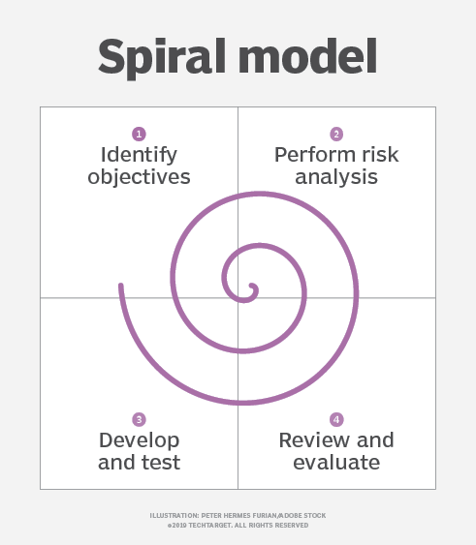
SYSTEM DEVELOPMENT ACTIVITIES
Spiral Improvement: Cycle through planning, risk, prototype, and evaluation, constantly evolving with user insights and testing.
Early Risk Shield: Identify and address potential threats early, ensuring project stability and budget control.
Prototype Powered: Build and test prototypes at each stage, validating design and gathering user input for informed progress.
User-Driven Design: Continuously listen to users and incorporate their feedback, shaping the system around their needs.

Slide 7
Requirement Identification
Learning from Existing Systems: We'll analyze strengths and weaknesses of existing management solutions to avoid their pitfalls and build on their successes.
Deep Dive: Examining popular platforms like Webnovel, NovelUpdates, ScribbleHub, Bookwalker, MyAnimeList, and AniList.
Listening to Your Needs: Through surveys and interviews, we'll gather your feedback to ensure the system meets your specific needs and desired functionalities.

Slide 8
Analyzing Existing Systems
Content Access: Easy discovery and consumption of novels.
Organization Tools: Track progress and manage library.
Social Features: Reader interaction and community building.
Engagement Tools: Keep users hooked and invested. Gaps We'll Address:
Cross-Platform Tracking: Consistent progress across websites.
Improved Progress Management: Organize and manage reading activity.
Enhanced Personalization: Customize the reading experience.
Streamlined User Feedback: Capture and implement user ideas.

Slide 9
Gathering User Feedback
Survey Focus: Targeting readers who juggle multiple platforms to understand their frustrations and desires.
In-Depth Insights: Conducting interviews to gain personal perspectives on reading habits, tracking preferences, and community needs.
Online Buzz Analysis: Monitoring forums and social media to identify broader trends and common pain points.

Slide 10
Feasibility Study
Technical Viability: We'll explore available technologies, software tools, and expertise to build a reliable and efficient system.
Operational Sustainability: We'll choose a scalable and cost-effective infrastructure to ensure long-term system maintainability.
Economic Value: We'll evaluate the potential benefits of the system for both users and the development team, focusing on increased engagement and value.

Slide 11
HOW TO DO?
Tech Savvy: We'll leverage our existing skills & beginner-friendly frameworks like Bootstrap or Django for rapid development.
Resourceful & Collaborative: We'll utilize online resources and potentially seek expert guidance from peers or faculty.
Free Hosting: We'll choose platforms like GitHub Pages or Google Cloud Platform to avoid hosting costs.
Prioritized Features: We'll focus on developing essential features within the semester using available resources.
Teamwork & Expertise: We'll assign tasks based on strengths and utilize our supervisor's expertise for guidance.
Version Control: We'll implement Git for easy tracking of progress and changes.
Learning & Value: We'll align the project with learning goals and showcase its potential to gain new skills and contribute to the community.

Slide 12
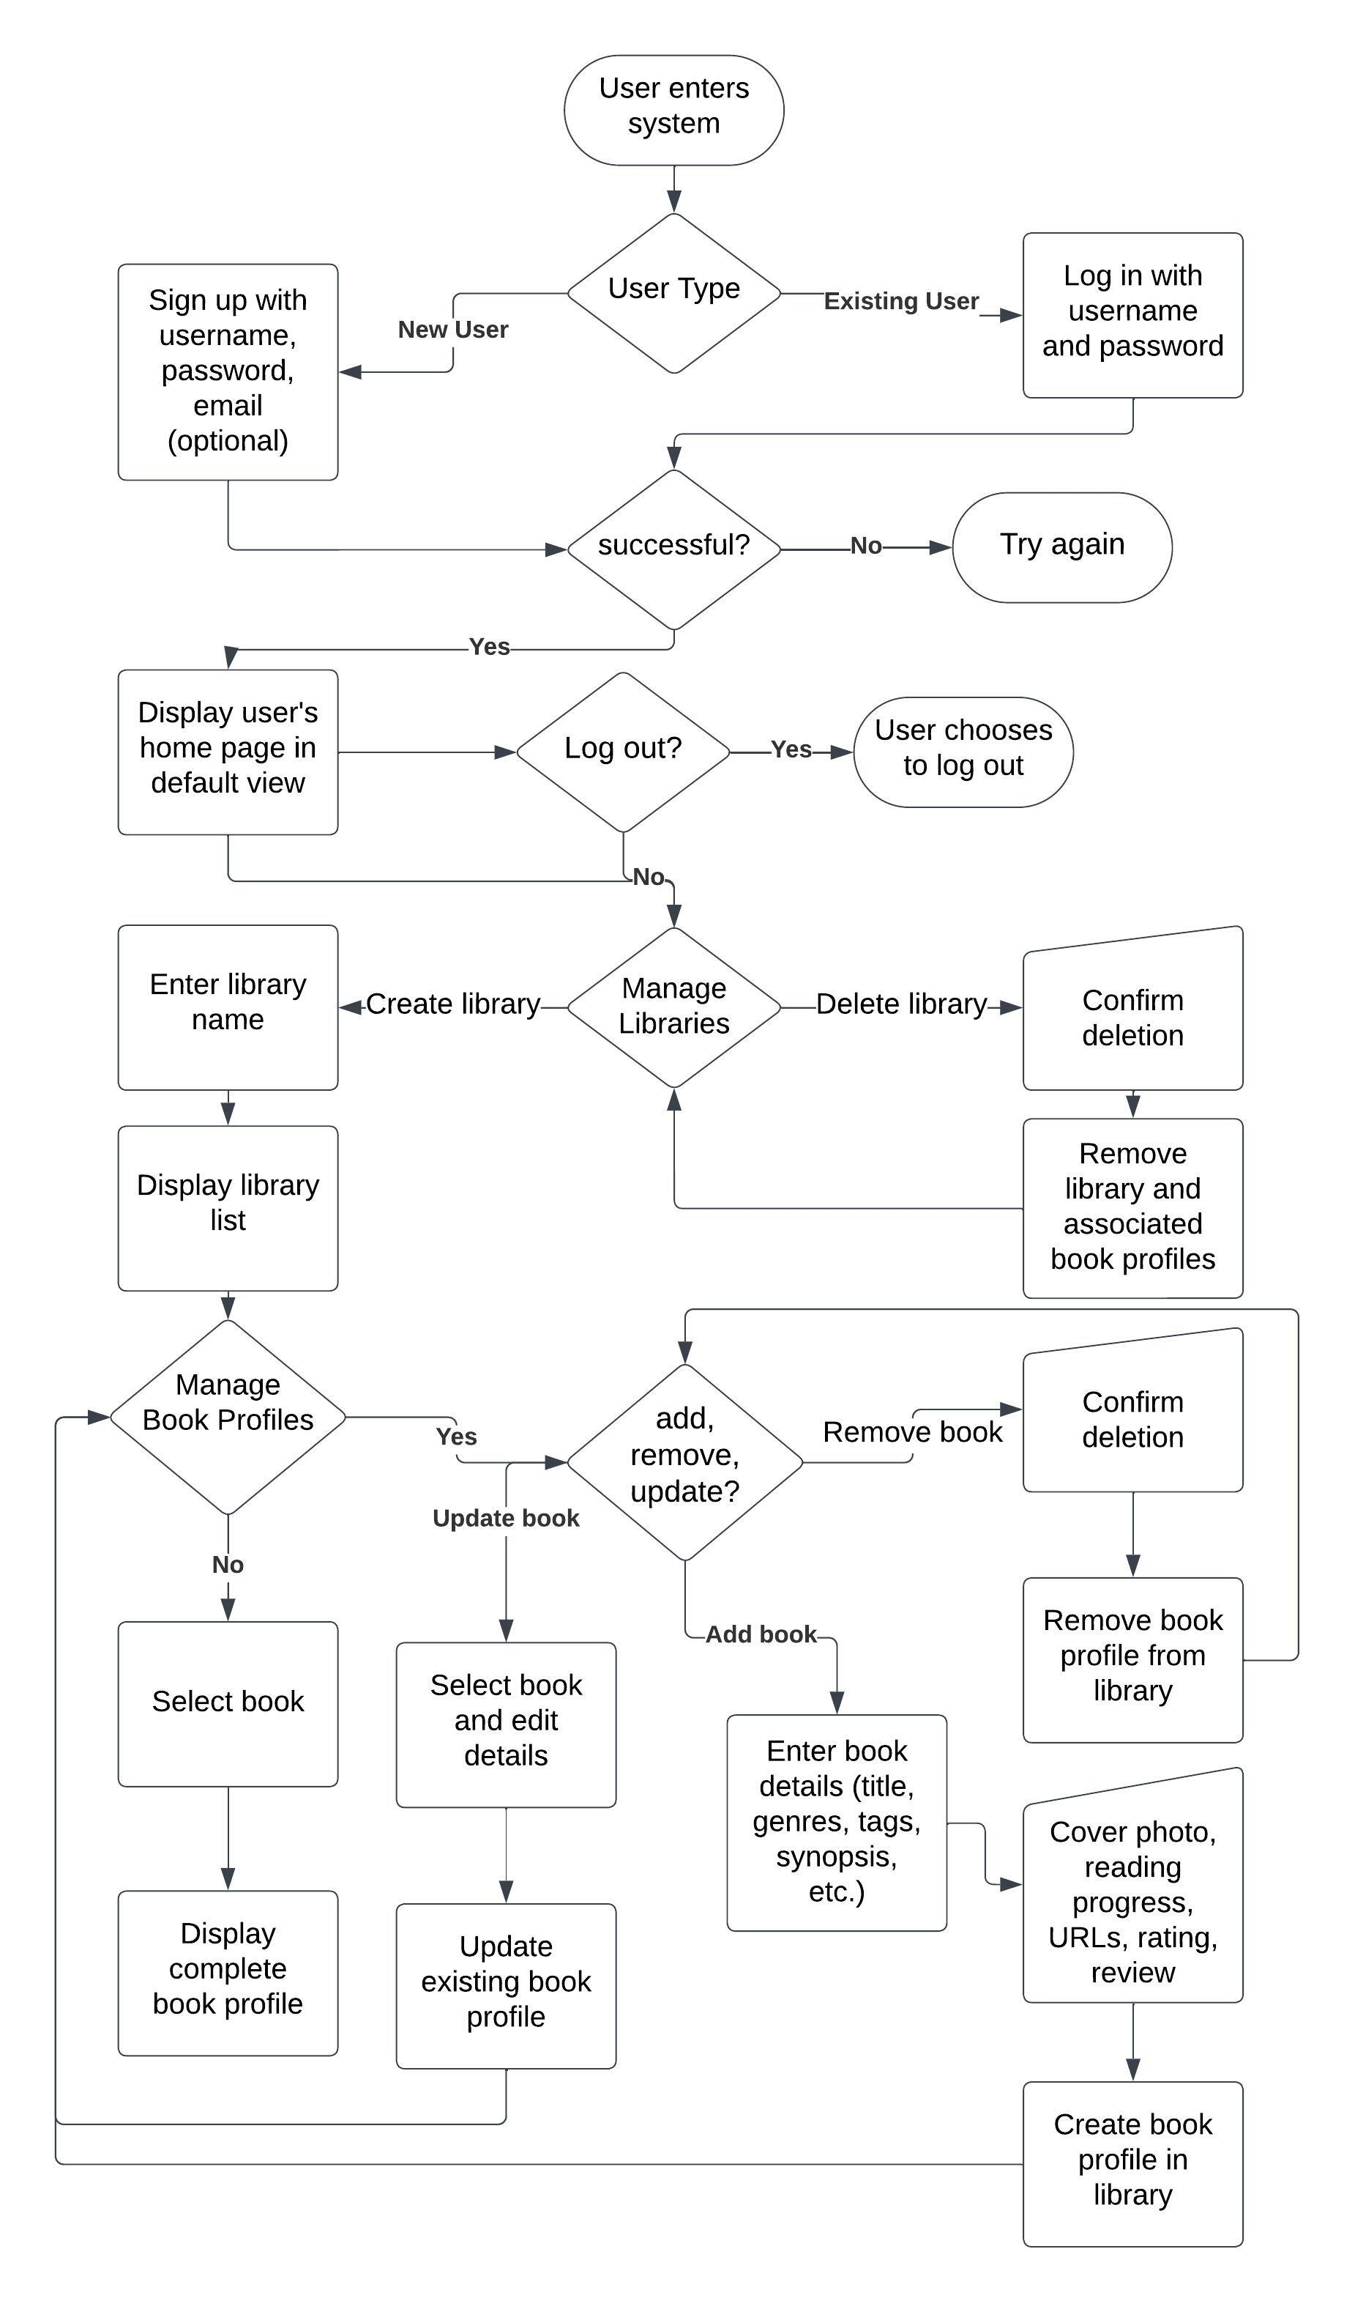
High-Level Design of System
System Flow Chart

Slide 13
Methodology of the Proposed System
Responsive & User-Friendly: HTML5, CSS3, & JS for smooth access across devices.
Secure & Efficient Back-End: PHP handles server logic, authentication, & database interactions.
Centralized Data: MySQL/MariaDB stores book profiles, user preferences, & system settings.
Organized & Searchable: Efficient indexing for fast book discovery within libraries.
Privacy Focus: Only minimal user info (username, password, optional email) stored.
Targeted Feedback: primarily from students & supervisors, with potential student inclusion.

Slide 14
Working Mechanism of the Proposed System
Effortless Exploration: Clear menus and organized content for intuitive browsing.
Personalization: Users choose how they see their libraries (alphabetical, genre, etc.).
Multiple Libraries: Categorize your literary collection through libraries.
Detailed Book Profiles: Track progress, store links, add ratings and reviews.
Full Control: Create, read, update, and delete book profiles at will.
Offline Access: Manage your library on the go, changes sync online later.
Basic Protection: Password-protected accounts and restricted access.
Privacy Focus: Minimal user data stored (username, password, optional email).

Slide 15
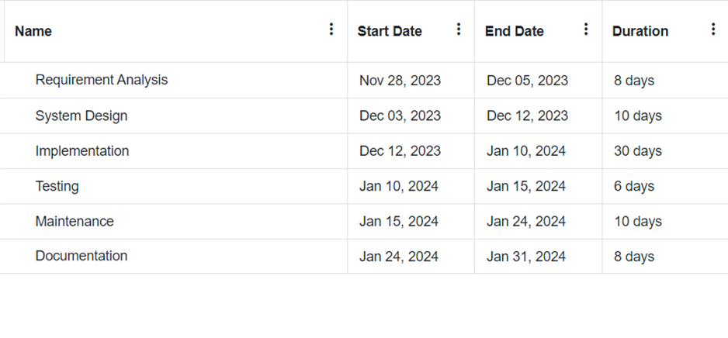
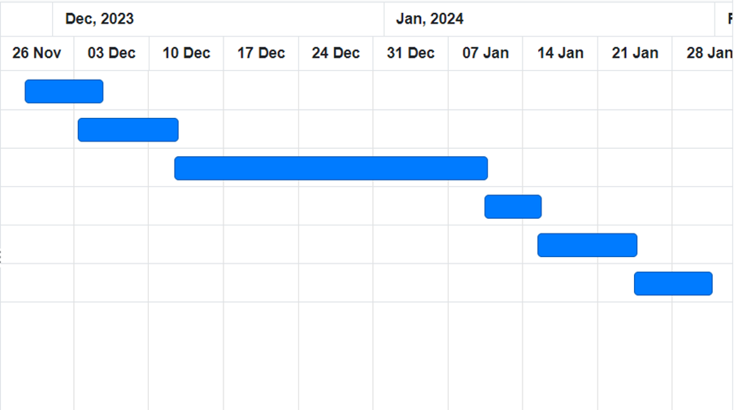
GANTT CHART

Slide 16
EXPECTED OUTCOME
The Online Literary Management System is expected to:
Enhance user experience with efficient and personalized library management.
Increase discoverability of desired literary content within personal collections.
Demonstrate the feasibility of creating a user-centric and functionally rich system.

Slide 17
THANK YOU
By:
Sujal Bajracharya
Balram Magar

